Slide 1

Stock Market Prediction
Prepared By:
Jaimin Prajapati
Parth Patel

Slide 2
Outline
Introduction
Objective
Technology Used
Algorithm Used
System Architecture
Project Features
Challenges we faced
Future Work

Slide 3
Introduction
We propose a Stock Market Prediction System that analyses stock data and suggests a ranked basket of stocks.
Apply different techniques of data mining on data and find similarities among various data items.
Use live prices, historical data and twitter tweets for process.

Slide 4
Objective
The objective of this recommender system is to support stock market traders, individual investors and fund managers in their decisions.

Slide 5
Technology Used
Technology | Machine Learning, Android
Tools | PyCharm, Android studio
Language | Python, Java

Slide 6
Algorithm Used
Artificial Neural Network
Support Vector Machine
Sentimental Analysis

Slide 7
Artificial Neural Network
Artificial neural networks (ANNs) is a computational model used in computer science and other research disciplines, which is based on a large collection of simple neural units, loosely analogous to the observed behaviour of a biological brain's axons.
Each neural unit is connected with many others, and links can enhance or inhibit the activation state of adjoining neural units. Each individual neural unit computes using summation function. There may be a threshold function or limiting function on each connection and on the unit itself, such that the signal must surpass the limit before propagating to other neurons.
These systems are self-learning and trained, rather than explicitly programmed.

Slide 8
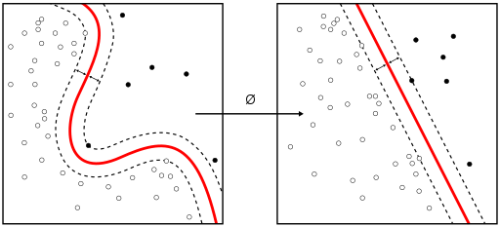
Support Vector Machine
“Support Vector Machine” (SVM) is a supervised machine learning algorithm which can be used for both classification or regression challenges.
However, it is mostly used in classification problems. In this algorithm, we plot each data item as a point in n-dimensional space (where n is number of features you have) with the value of each feature being the value of a particular coordinate.
Then, we perform classification by finding the hyper-plane that differentiate the two classes very well (look at the below snapshot).

Slide 9
Sentimental Analysis
Sentiment Analysis is the use of natural language processing, statistics, and text analysis to extract, and identify the sentiment of text into positive, negative, or neutral categories. We often see sentiment analysis used to arrive at a binary decision: somebody is either for or against something, users like or dislike something, or the product is good or bad .
Sentiment analysis is also called opinion mining since it includes identifying consumer attitudes, emotions, and opinions of a company’s product, brand, or service.

Slide 10
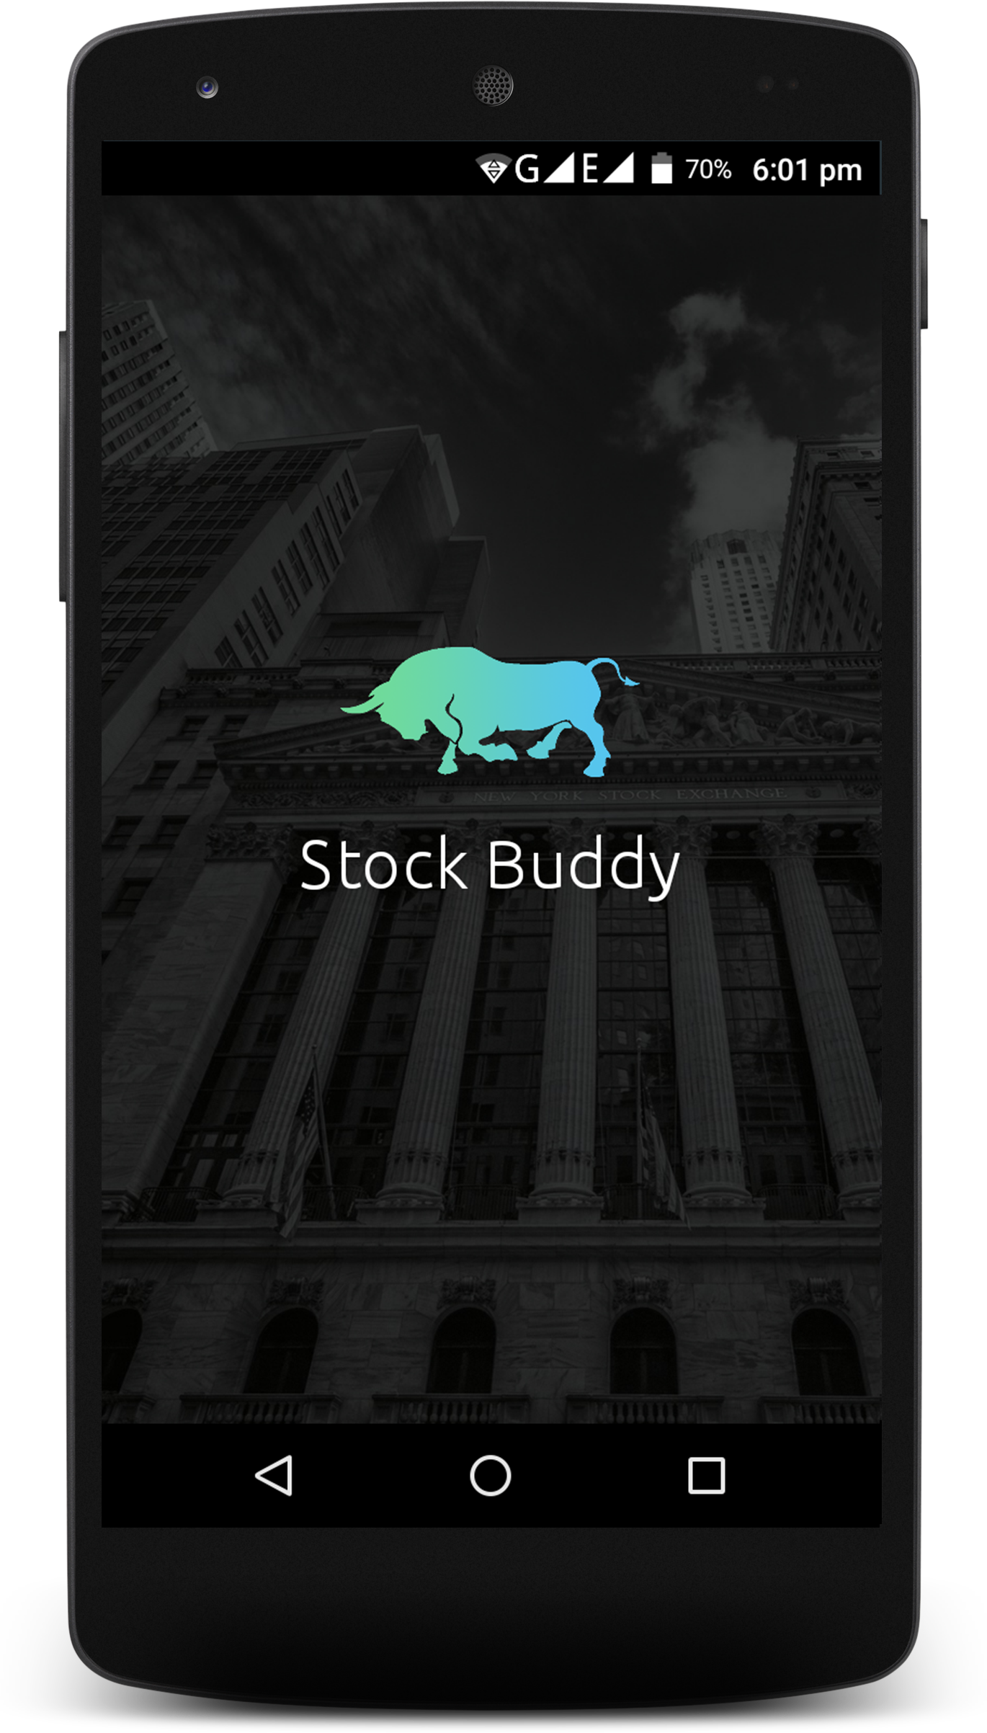
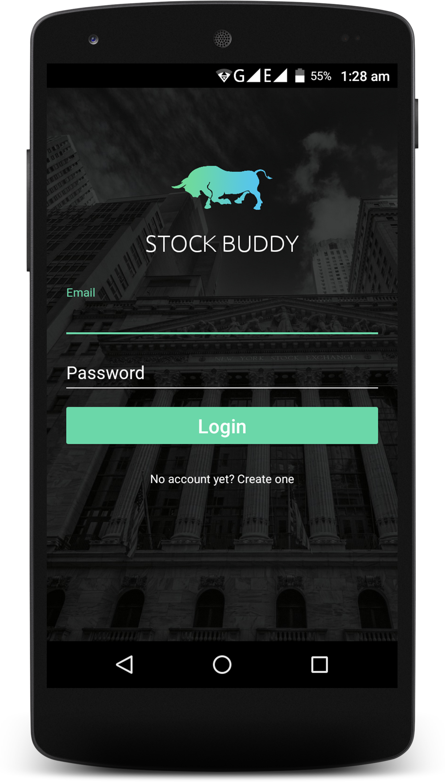
Screen Shots

Slide 11
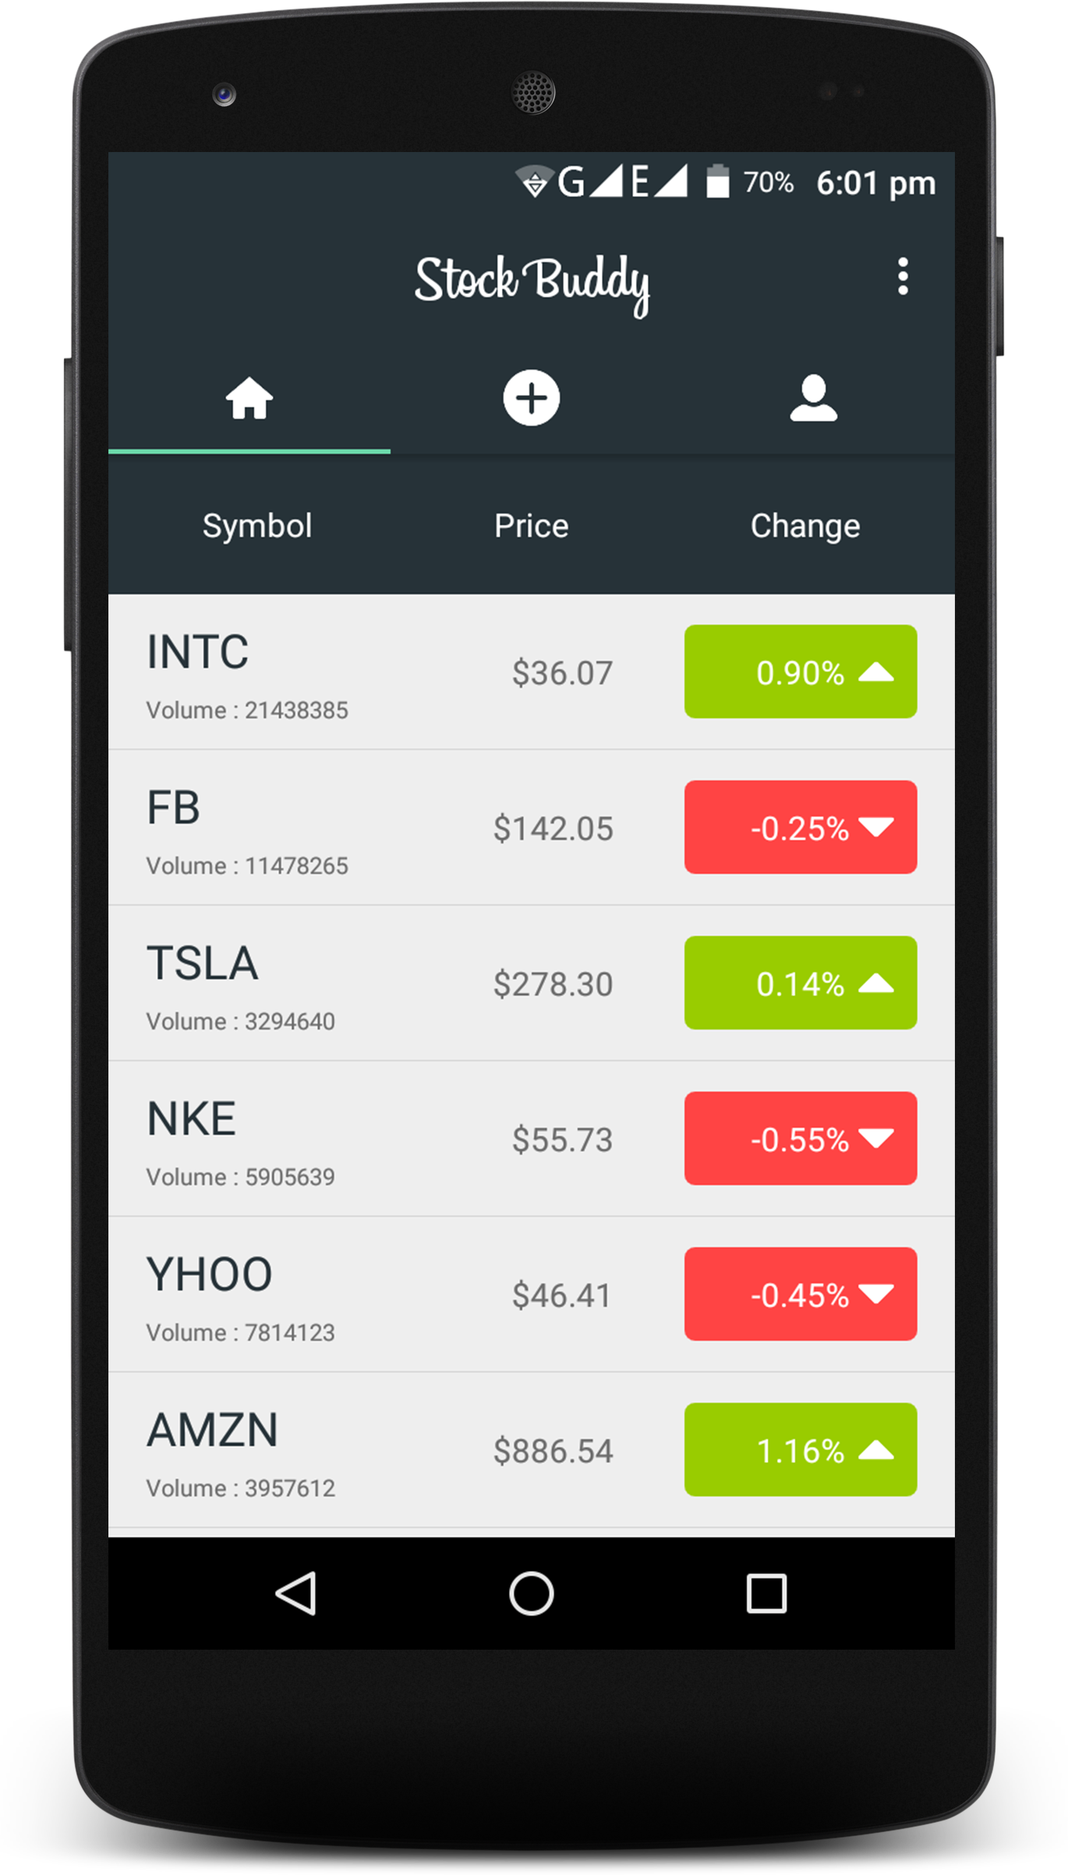
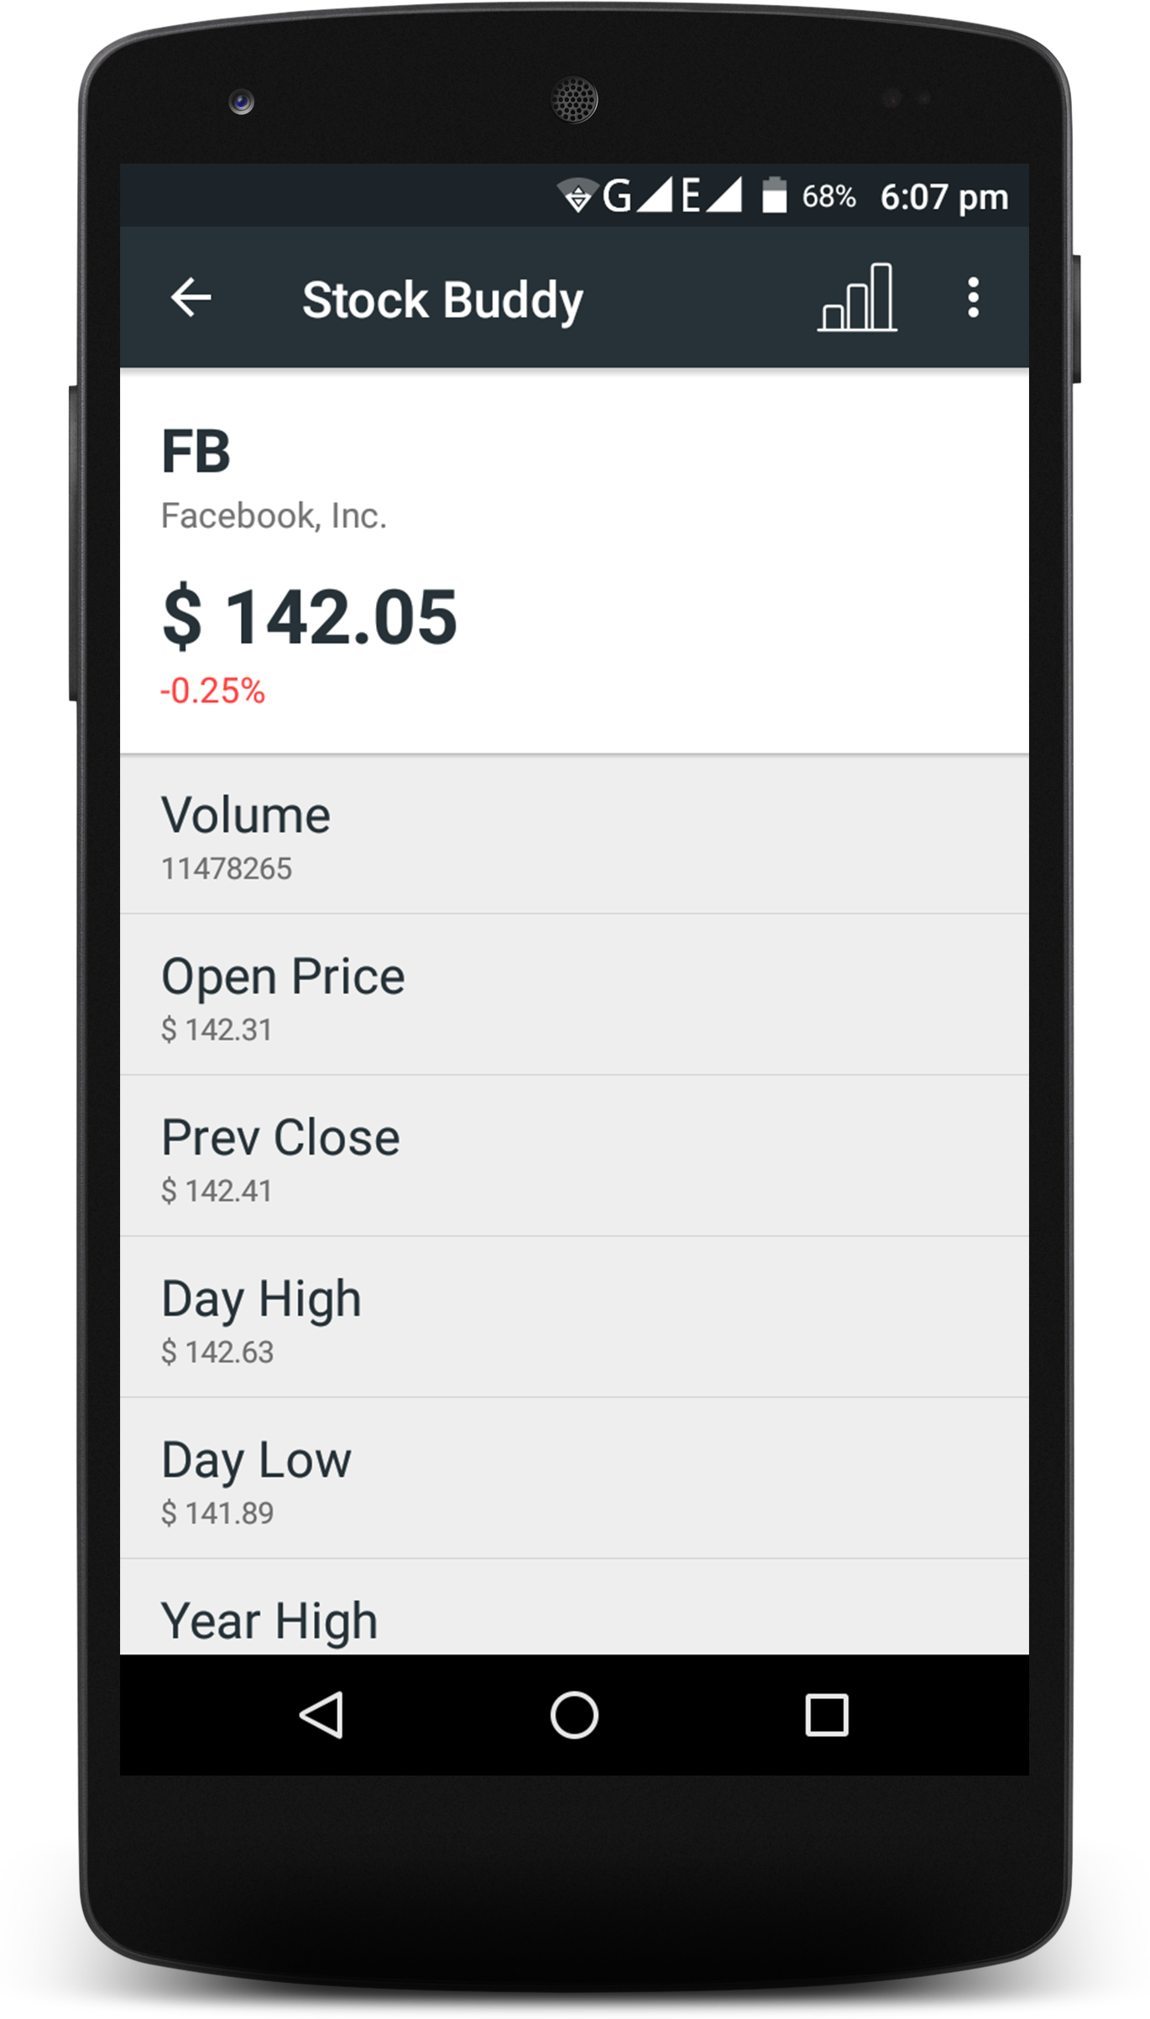
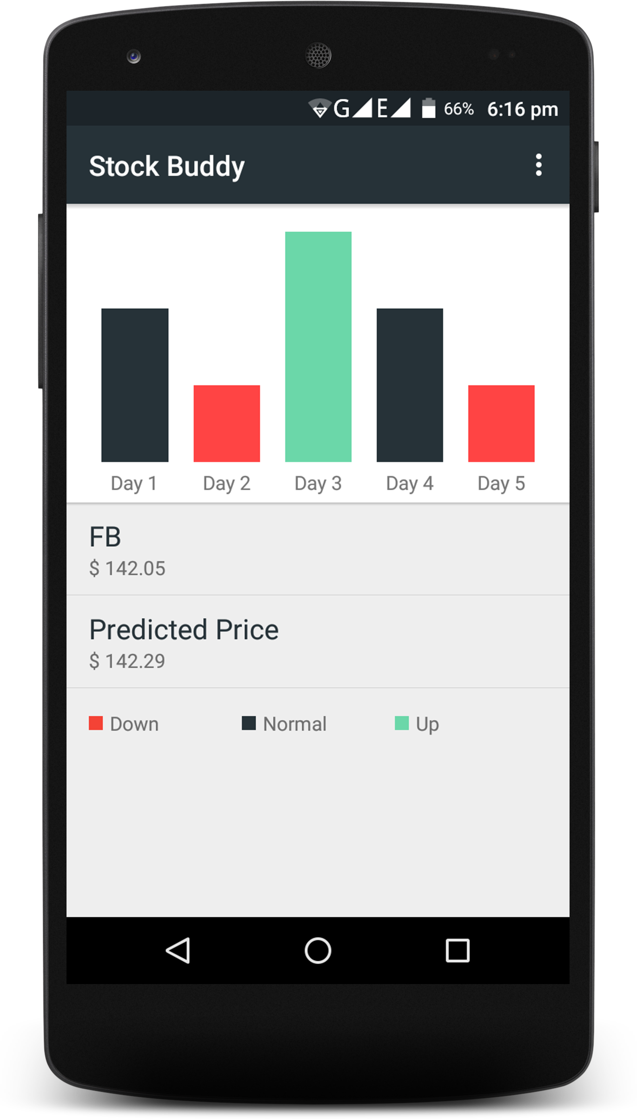

Slide 12
Challenges Faced
Following challenge have faced while developing this system:
1. Neural network architecture i.e. number of neurons and batch size for prediction
2. Number of Feature parameters i.e. number of input to neural network and support vector machines
3. Parameters for Support Vector machines
4. Understanding of neural network and support vector machine

Slide 13
Conclusion and Future Work
As we have developed stock market prediction system using historical data and sentimental analysis on tweet, We will further look to make our neural network model more faster.
We will try to make uniform neural network model for every company and wants extends our model for every company to make precise prediction
We have considered NASDAQ Stock exchange for this model, We will make neural network model for Indian stock market

